Slide 1

Big Data Analysis FINAL- EXAM CAPSTONE PROJECT
Names: NDAMIRA Josias
ID: 27838
GROUP: B
Lecture: Eric Maniraguha

Slide 2
Project Overview:
Sector Selection
Youth Employment in Rwanda.
Problem Statement
“How can we identify and visualize patterns in youth employment across Rwanda using national survey data?”
Dataset Identification
Dataset title: Youth_Thematic_Report_EICV7 and EICV7_Tables_Youth_Thematic_Report
Source Link: https://www.statistics.gov.rw/statistical-publications/gender-and-youth/youth
Data Structure: Unstructured.
The research finds that youth employment in Rwanda is influenced by Gender, Age, education and geographical location.

Slide 3
PYTHON ANALYTICS TASKS
Data cleaning
- Loaded and Preview My Excel File.
- Useful sheets:
'Table 5.1', Youth Workforce to Population ratio by urban/rural, province, age group, quintiles
'Table 5.2', Actual hours worked by sex and age
'Table 5.4', Youth working for wage by sector and sex
'Table 5.6', Distribution by occupation group
'Table 2.2', Youth distribution by province
'Table 3.3', Youth attending vocational schools
'Table 4.1', Computer literacy by demographics
- I saved the extracted from the Dataset.
- Load the Sheets into Data Frames.
- Loop through each data frame and handle missing values and formatting.
- Handle Outliers.

Slide 4
Exploration Flow for Each Table
Sheet Name | Focus Area | Why It's Important
Table5.1 | Youth labor force participation | Shows who’s in or out of the workforce
Table5.2 | Youth employment status breakdown | Helps identify gaps between employment and job type
Table5.4 | Hours worked & wage employment | Reveals underemployment and quality of jobs
Table5.6 | Employment by industry/sector | Highlights economic structure and sector disparities
Table2.2 | Age & sex distribution | Essential for demographic context
Table3.3 | Education levels across groups | Links educational attainment to employment trends
Table4.1 | Access to ICT & occupation type | Explores tech skills and job category relationships
The Process:
- I checked the structure of Tables This code will help me to get a structure of my tables.
- I checked for Missing Data, renamed Columns for Clarity, dropped Unnecessary Columns.
- Converted Numeric Columns to ensure pandas treats them as numbers, enabling descriptive stats and visualizations.
- Generated Descriptive Statistics.
- Visualized Distributions.
- Saved the cleaned Dataset.

Slide 5
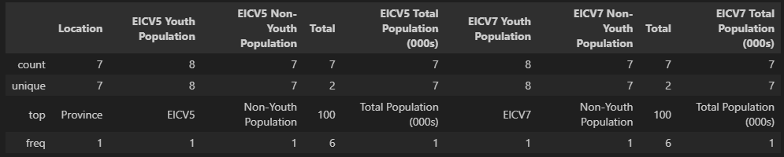
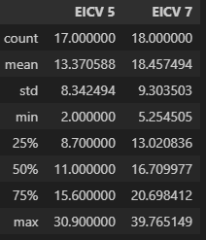
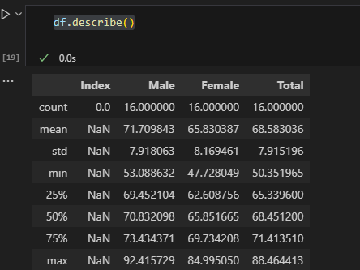
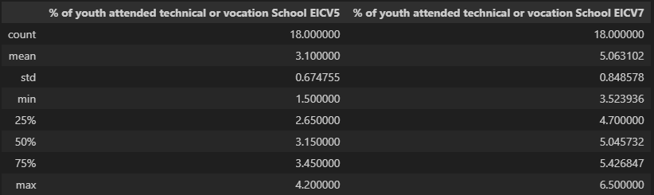
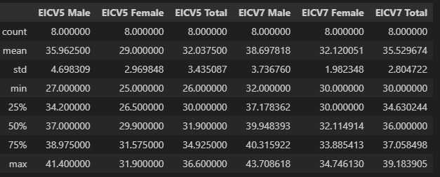
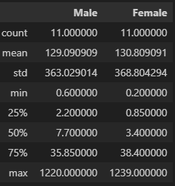
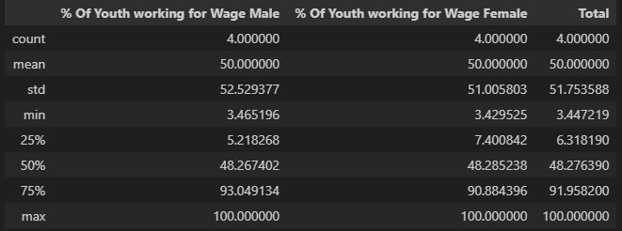
Generated Descriptive Statistics

Slide 6
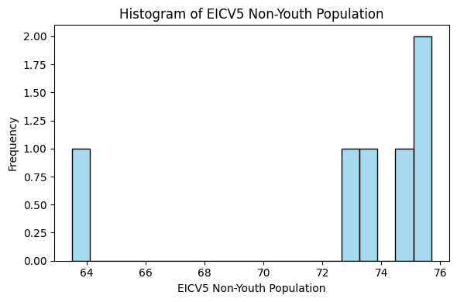
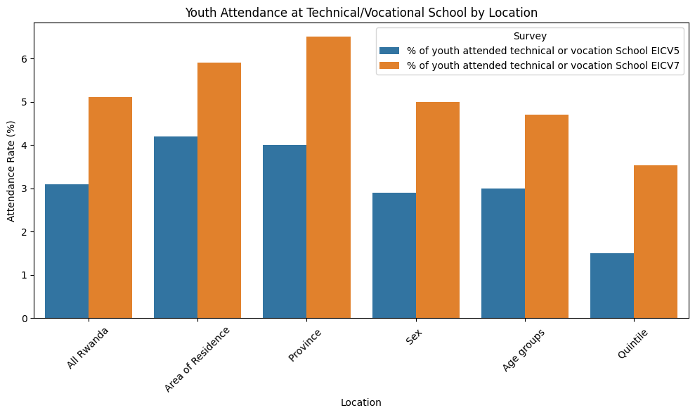
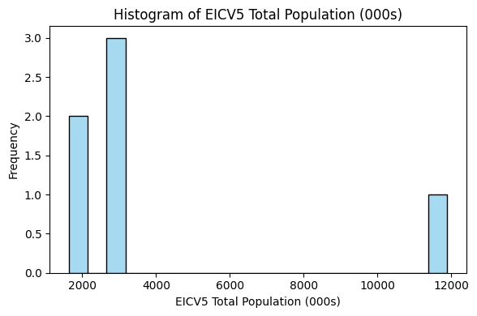
Visualized Distributions

Slide 7
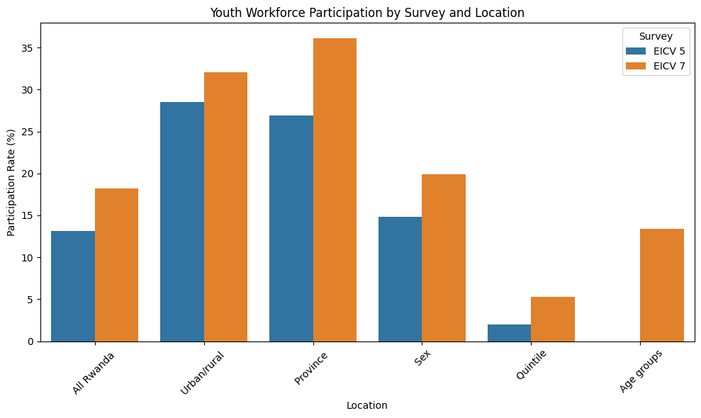
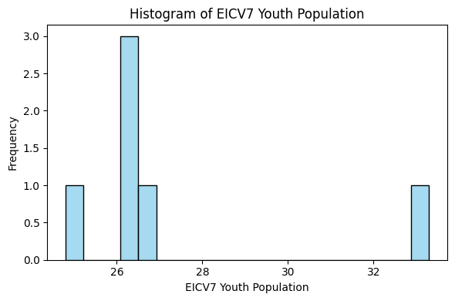
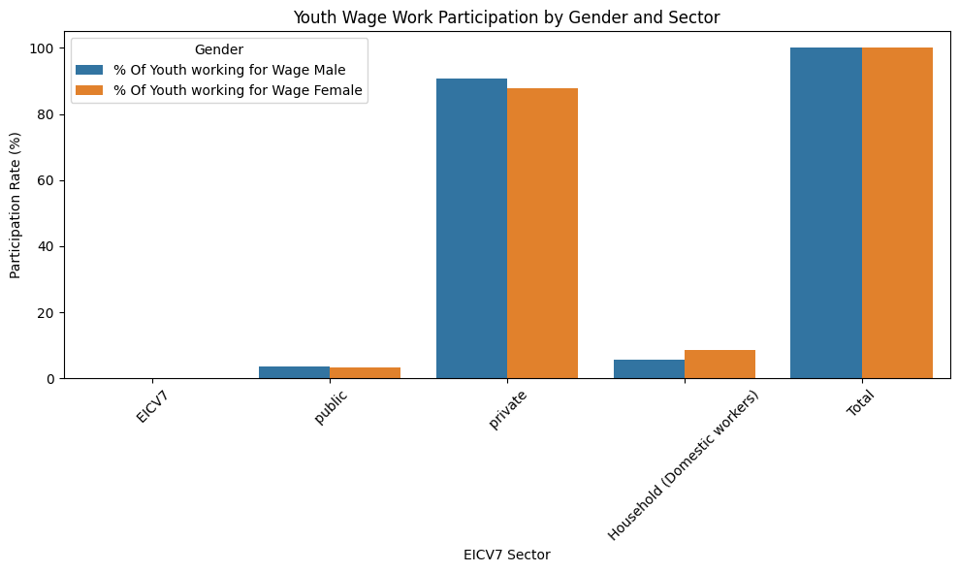
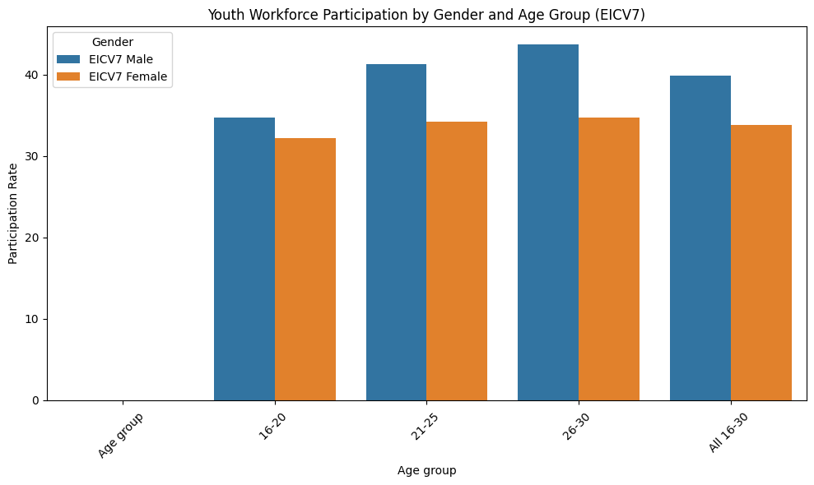

Slide 8
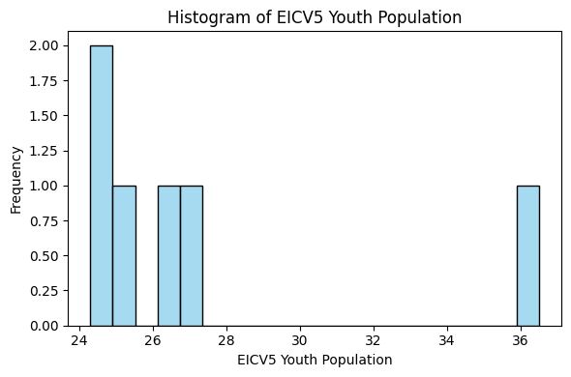
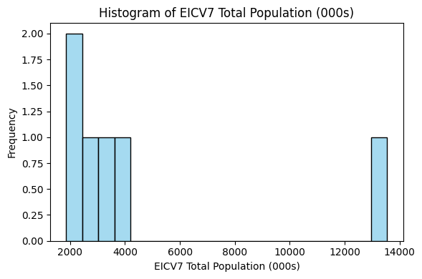
After I Applied Clustering
Emerging tables
Merge into One Unified Data Frame.
Prep for Clustering.
Apply Clustering & Interpret

Slide 9
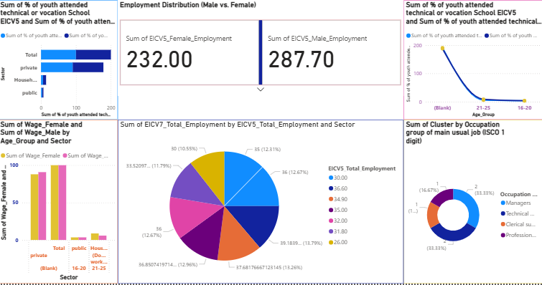
POWER BI DASHBOARD TASKS
Insight | Visual Type
Vocational training by sector | Stacked bar chart
Employment comparison | Cards
Attendance trends (EICV5 vs EICV7) | Line chart
Cluster segmentation | Donut or radar chart
Occupation distribution | Tree map or pie chart
Click here to access it https://drive.google.com/file/d/1WAT26O9tY2eSaCM6VtjVrcQMUrU87dUh/view?usp=sharing

